Slide 1
EPOD WEBPORTAL

Slide 2
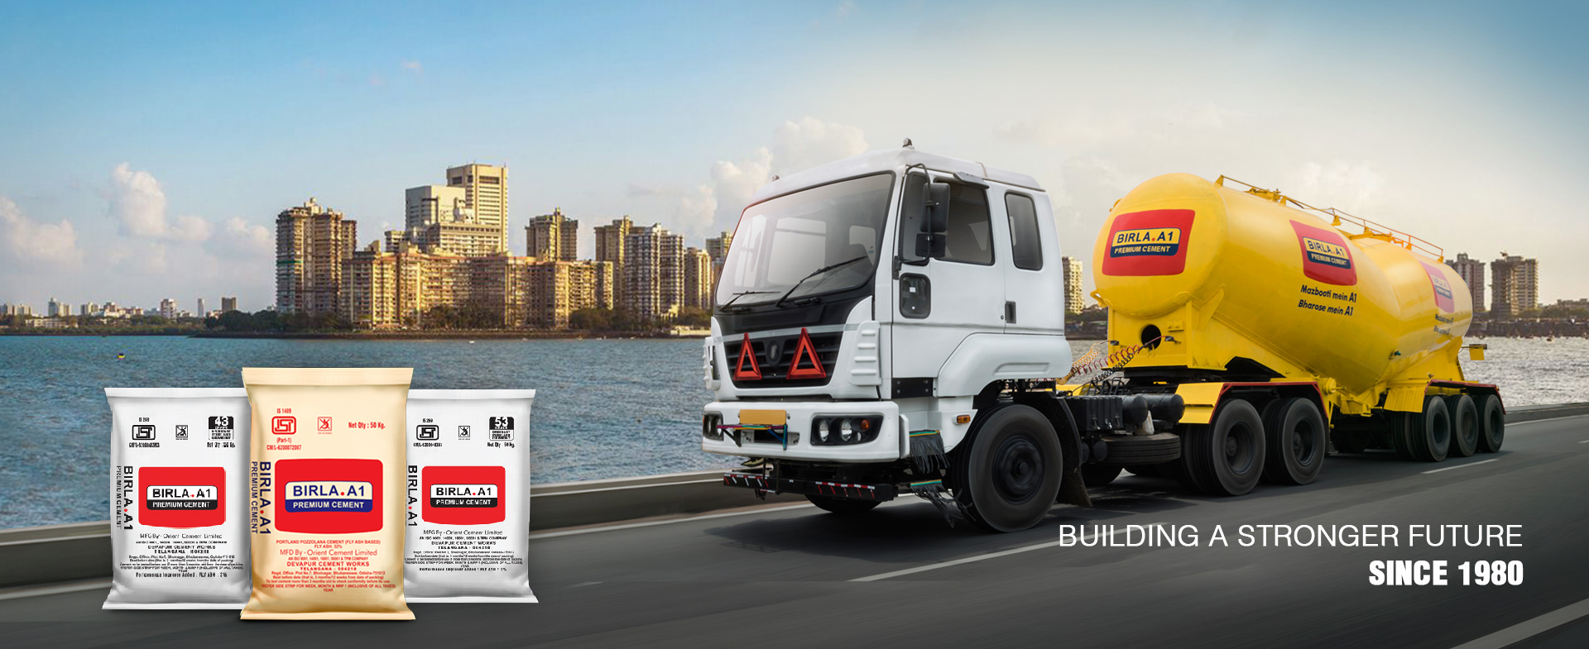

T R A N S P O R T E R P O R T A L
Vendor details and version

Slide 3


T R A N S P O R T E R P O R T A L
MEMBER LOGIN
User Name
Password
Forgot Password
SIGN IN
Vendor details and version

Slide 4
Driver Tab
To be added
Vehicle No | Driver Name | Driver Mobile Number | Shipment Date | Destination Name | Tracking Type | Driver acceptance | Driver Location | Modify

Slide 5
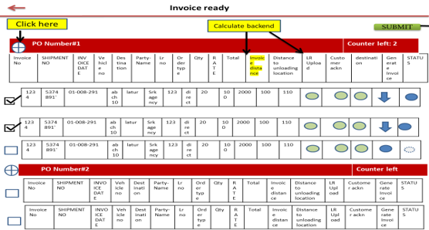
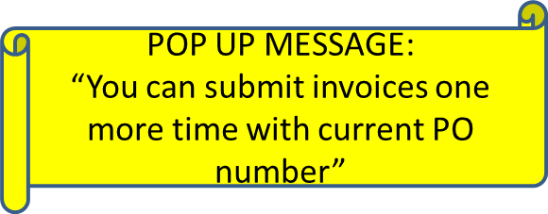
Every invoice should flow to invoice ready screen irrespective of three check points.
PO counter Logic:
The rate should be calculated in the back ground(qty*rate)
Po which satisfied three check point(destination, lr upload, cust ack) should only be allowed to submit.
-In order to bring control on the invoice raise by transporter, we want to implement counter logic system. If a PO contains 10 invoice, he can use it for only 2 times maximum In the first go he has submitted 4 invoices, all the other 6 invoices should be submitted in the next one.
So the counter should be adjusted to 1 after the invoice raise.
In the next raise it should a pop-up message

Slide 6
Invoice ready
Click here
SUBMIT
LR No :
LR Date :
PO Number#1 | Total po cost | Counter left
PO Number#2 | Total po cost | Counter left

Slide 7
Invoice ready
Click here
Calculate backend
SUBMIT
LR No :
LR Date :
PO Number#1 | Counter left
Invoice No | SHIPMENT NO | INVOICE DATE | Vehicle no | Destination | Party-Name | Lr no | Order type | Qty | RATE | Total | Invoice distance | Distance to unloading location | LR Upload | Customer ackn | destination | Generate Invoice | STATUS
Click to Pdf generation
1234 | 5374891` | 01-008-291 | abch10 | latur | Srk agency | 123 | direct | 20 | 100 | 2000 | 100 | 110
1234 | 5374891` | 01-008-291 | abch10 | latur | Srk agency | 123 | direct | 20 | 100 | 2000 | 100 | 110
PO Number#2 | Counter left
Invoice No | SHIPMENT NO | INVOICE DATE | Vehicle no | Destination | Party-Name | Lr no | Order type | Qty | RATE | Total | Invoice distance | Distance to unloading location | LR Upload | Customer ackn | Generate Invoice | STATUS
Invoice No | SHIPMENT NO | INVOICE DATE | Vehicle no | Destination | Party-Name | Lr no | Order type | Qty | RATE | Total | Invoice distance | Distance to unloading location | LR Upload | Customer ackn | Generate Invoice | STATUS

Slide 8
Invoice ready
Click to download invoice
Click here
Calculate backend
SUBMIT
LR No :
LR Date :
PO Number#1 | Counter left
Invoice No | SHIPMENT NO | INVOICE DATE | Vehicle no | Destination | Party-Name | Lr no | Order type | Qty | RATE | Total | Invoice distance | Distance to unloading location | LR Upload | Customer ackn | destination | Generate Invoice | STATUS
1234 | 5374891` | 01-008-291 | abch10 | latur | Srk agency | 123 | direct | 20 | 100 | 2000 | 100 | 110
1234 | 5374891` | 01-008-291 | abch10 | latur | Srk agency | 123 | direct | 20 | 100 | 2000 | 100 | 110
Status button active
PO Number#2 | Counter left
Invoice No | SHIPMENT NO | INVOICE DATE | Vehicle no | Destination | Party-Name | Lr no | Order type | Qty | RATE | Total | Invoice distance | Distance to unloading location | LR Upload | Customer ackn | Generate Invoice | STATUS
Invoice No | SHIPMENT NO | INVOICE DATE | Vehicle no | Destination | Party-Name | Lr no | Order type | Qty | RATE | Total | Invoice distance | Distance to unloading location | LR Upload | Customer ackn | Generate Invoice | STATUS

Slide 9

Invoice ready
Click here
Click to submit
Calculate backend
SUBMIT
LR No :
LR Date :
PO Number#1 | Counter left: 2
POP UP MESSAGE:
“You can submit invoices one more time with current PO number”
Invoice No | SHIPMENT NO | INVOICE DATE | Vehicle no | Destination | Party-Name | Lr no | Order type | Qty | RATE | Total | Invoice distance | Distance to unloading location | LR Upload | Customer ackn | destination | Generate Invoice | STATUS
1234 | 5374891` | 01-008-291 | abch10 | latur | Srk agency | 123 | direct | 20 | 100 | 2000 | 100 | 110
1234 | 5374891` | 01-008-291 | abch10 | latur | Srk agency | 123 | direct | 20 | 100 | 2000 | 100 | 110
1234 | 5374891` | 01-008-291 | abch10 | latur | Srk agency | 123 | direct | 20 | 100 | 2000 | 100 | 110
PO Number#2 | Counter left
Invoice No | SHIPMENT NO | INVOICE DATE | Vehicle no | Destination | Party-Name | Lr no | Order type | Qty | RATE | Total | Invoice distance | Distance to unloading location | LR Upload | Customer ackn | Generate Invoice | STATUS
Invoice No | SHIPMENT NO | INVOICE DATE | Vehicle no | Destination | Party-Name | Lr no | Order type | Qty | RATE | Total | Invoice distance | Distance to unloading location | LR Upload | Customer ackn | Generate Invoice | STATUS

Slide 10
SUBMIT
LR No :
LR Date :
PO Number#1 | Counter left: 1
Invoice No | SHIPMENT NO | INVOICE DATE | Vehicle no | Destination | Party-Name | Lr no | Order type | Qty | RATE | Total | Invoice distance | Distance to unloading location | LR Upload | Customer ackn | destination | Generate Invoice | STATUS
Only pdf download and status button will be active for submitted invoice. Other fields should look in grey
1234 | 5374891` | 01-008-291 | abch10 | latur | Srk agency | 123 | direct | 20 | 100 | 2000 | 100 | 110
1234 | 5374891` | 01-008-291 | abch10 | latur | Srk agency | 123 | direct | 20 | 100 | 2000 | 100 | 110
1234 | 5374891` | 01-008-291 | abch10 | latur | Srk agency | 123 | direct | 20 | 100 | 2000 | 100 | 110
1234 | 5374891` | 01-008-291 | abch10 | latur | Srk agency | 123 | direct | 20 | 100 | 2000 | 100 | 110
PO Number#2 | Counter left

